Slide 1
ELEMENTARY STATISTICS, BLUMAN
Shapes of Distributions (Part 1 of 2)
© 2019 McGraw-Hill Education. All rights reserved. Authorized only for instructor use in the classroom. No reproduction or further distribution permitted without the prior written consent of McGraw-Hill Education.

Slide 2
Objectives for this PowerPoint
Learn how to recognize the following common shapes of distributions of data.
Bell-shaped
Positively or right-skewed shaped
Negatively or left-skewed shaped

Slide 3
Shapes of Data Distributions
It is important to be able to recognize the shapes of data distributions.
The shape of the distribution usually determines the appropriate method that a statistician should use to analyze the data.
Distributions are most often not perfectly shaped. It is not necessary to have an exact shape, but rather to identify an overall pattern.

Slide 4
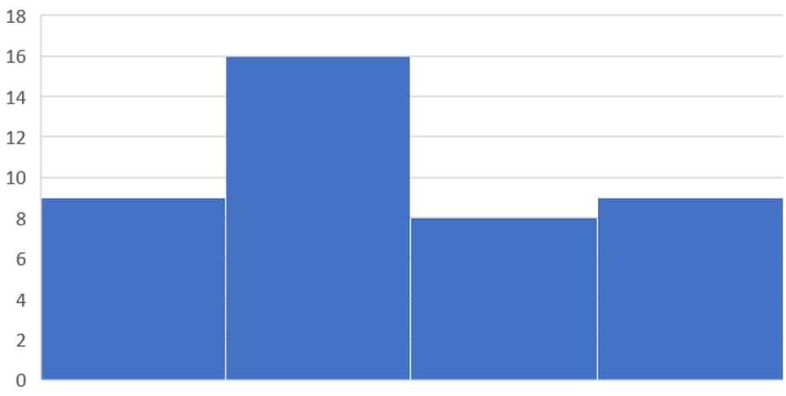
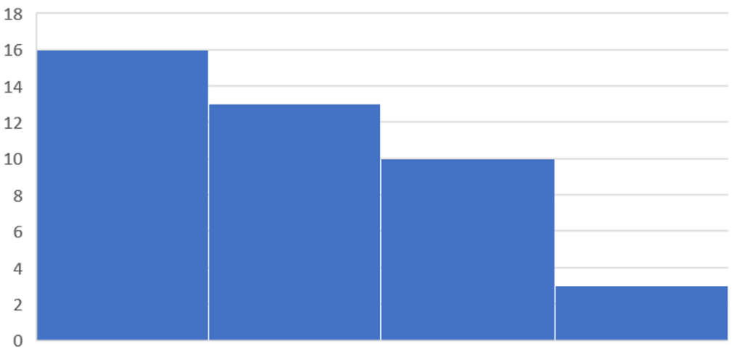
Shapes of Distributions

Slide 5
Bell-Shaped Distribution (1)
A bell-shaped distribution has a single peak and tapers off at either end and is roughly symmetric on both sides of the line running through the center.

Slide 6
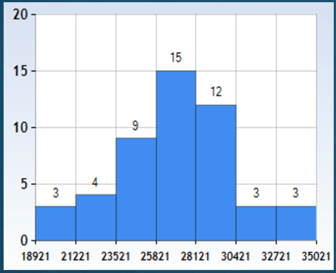
Bell-Shaped Distribution (2)
This histogram shows the average debt in $ for college graduates for 46 U.S. universities in the year 2015. Note that the distribution peaks in the center. And although it is not exactly symmetric on either side of the peak, it is close; and it does taper off at either end. So this distribution is roughly bell-shaped.
Jump to long description

Slide 7
Negatively or Left-Skewed
When the data values are clustered to the right and taper off to the left, a distribution is said to be negatively or left-skewed.

Slide 8
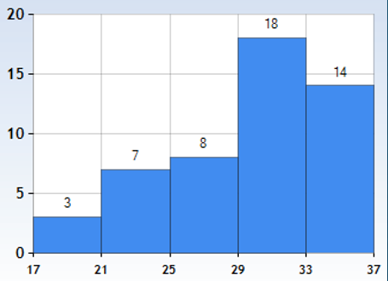
Negatively of Left-Skewed Distribution
The following histogram shows the ACT score distribution for the incoming 2016 freshman class at a top ranked university. The frequencies are in 100s. Note that the distribution peaks at the right, with clustering on either side of the peak and a noticeable taper to the left.
This is an example of a negative or left-skewed data set.
Jump to long description

Slide 9
Positively or Right-Skewed
When the peak of the distribution is to the left and the data values taper off to the right a distribution is said to be positively or right-skewed.

Slide 10
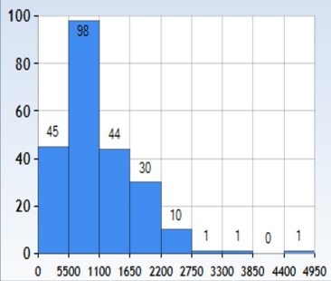
Positively or Right-Skewed Distribution
The following histogram shows the total subsidy in $1000s for athletic departments at 240 U.S. Universities in 2013. Note that the distribution peaks at the left, with clustering on either side of the peak and a noticeable taper to the right.
This is an example of a positively or right-skewed data set.
Jump to long description

Slide 11
Summary
In this PowerPoint we learned how to recognize the following common shapes of distributions of data.
Bell-shaped
Positively or right-skewed shaped
Negatively or left-skewed shaped

Slide 12
Appendix of Image Long Descriptions

Slide 13
Bell-Shaped Distribution (2) - Appendix
Heights of bars from left to right are 3, 4, 9, 15, 12, 3, 3.
The vertical axis is labeled from bottom to top 0, 5, 10, 15, 20.
The horizontal axis is labeled from left to right as 18921, 21221, 23521, 25821, 28121, 30421, 32721, 35021
Jump to the image

Slide 14
Negatively of Left-Skewed Distribution - Appendix
Five bars
Vertical axis from bottom to top is labeled 0, 5, 10, 15, 20.
Horizontal axis from left to right is labeled 17, 21, 25, 29, 33, 37.
Heights of the bars from left to right are 3, 7, 8, 18, 14.
Jump to the image

Slide 15
Positively or Right-Skewed Distribution - Appendix
The vertical axis is labeled from bottom to top as 0, 20, 40, 60, 80, 100.
The horizontal axis is labeled from left to right as 0, 550, 1100, 1650, 2200, 2750, 3300, 3850, 4400, 4950.
There are nine bars with height from left to right of 45, 98, 44, 30, 10, 1, 1, 0, 1.
Jump to the image

